Slide 1

ABE 715
Computer Programming
Lecture 8: Data Visualization
Matplotlib, Seaborn, and Engineering Plots
Dr. Kadeghe G. Fue
Department of Agricultural Engineering
1

Slide 2
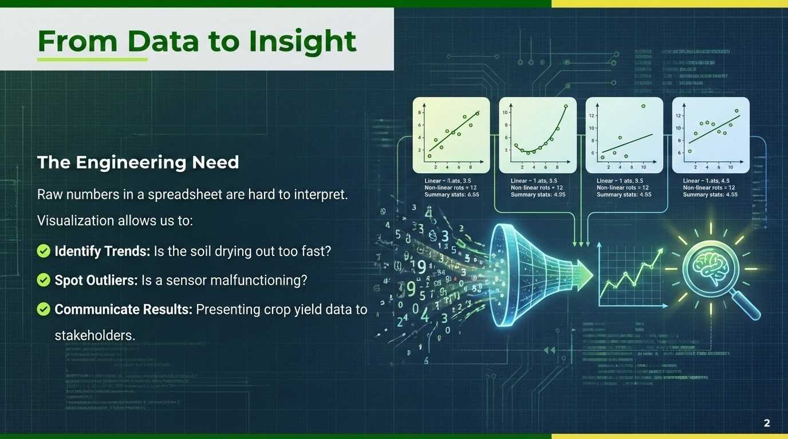

Slide 3
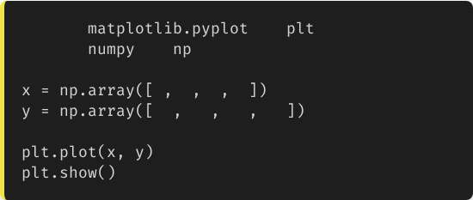
Matplotlib: The Foundation
Matplotlib is the most widely used Python plotting library.
import
as
import
as
We typically import the pyplot submodule as plt.
1
2
3
4
10
20
25
30
It mimics MATLAB's plotting style, making it familiar to many engineers.
3

Slide 4

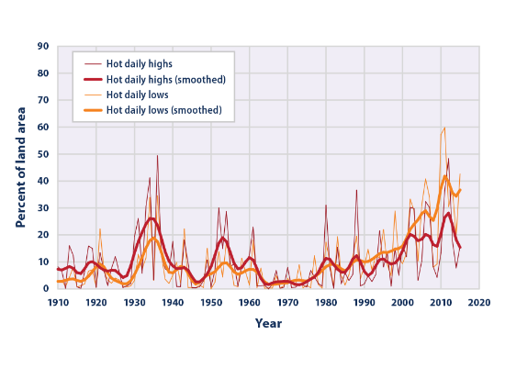
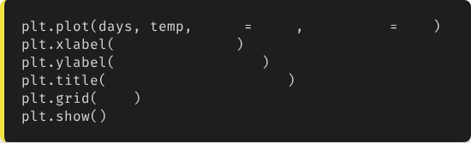
1. Line Plots (Time Series)
Monitoring Change
Best for continuous data like temperature over time.
color
'red'
linestyle
'--'
'Day of Month'
'Temperature (C)'
'Morogoro Daily Temp'
True
4

Slide 5
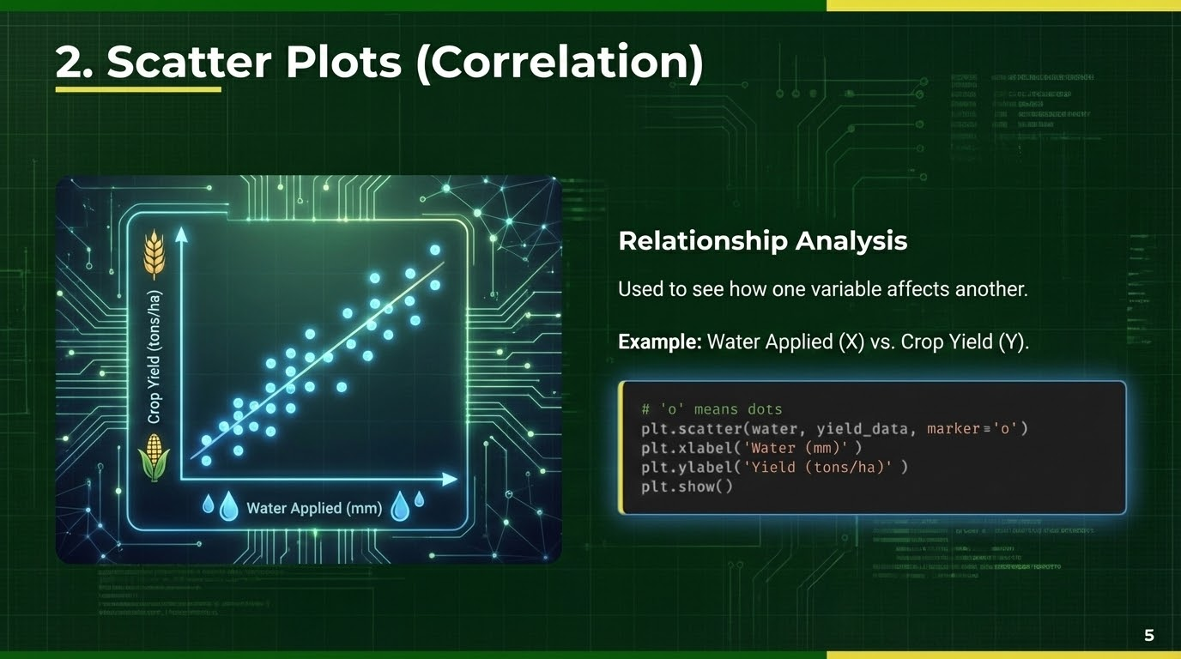

Slide 6
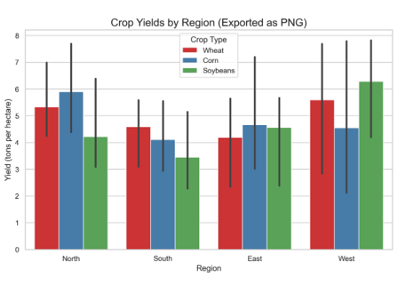
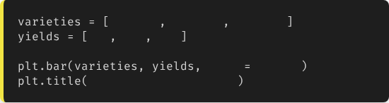
3. Bar Charts (Categorical)
Comparison
Compare values across different categories (e.g., Crop Varieties).
'Var A'
'Var B'
'Var C'
4.5
5.2
3.8
color
'green'
'Variety Performance'
6

Slide 7
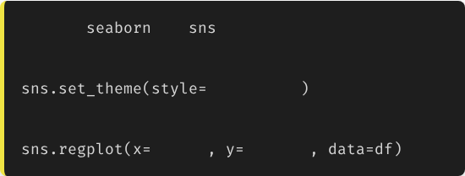
Seaborn: Statistical Beauty
Seaborn is built on top of Matplotlib. It creates beautiful, complex statistical plots with fewer lines of code.
import
as
# Set theme
•
Built-in themes (looks better by default).
"darkgrid"
•
Great for Heatmaps and Regression plots.
# Auto-regression plot
"Rain"
"Yield"
•
Works directly with Pandas DataFrames.
7

Slide 8

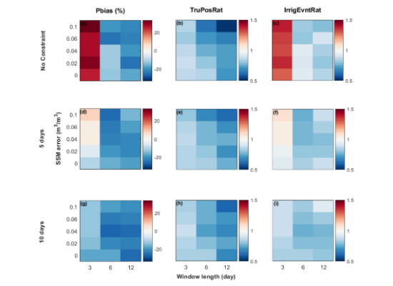
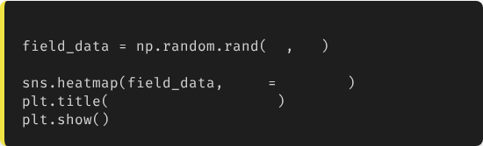
Case 1: Soil Moisture Heatmap
Spatial Variability
Imagine a grid of 10x10 sensors in a field. A heatmap shows wet and dry spots instantly.
# 10x10 matrix of random data
10
10
cmap
"YlGnBu"
'Soil Moisture Map'
8

Slide 9
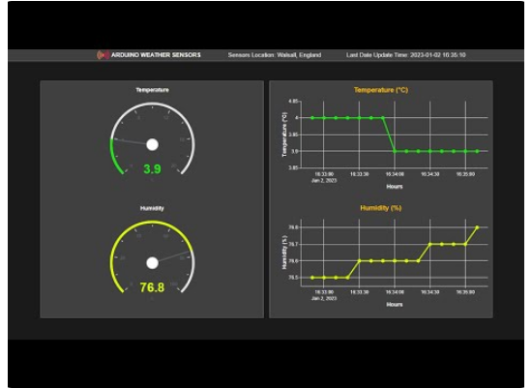
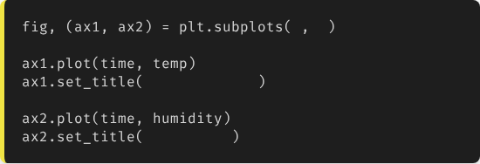
Case 2: Subplots (Dashboard)
The Engineering Dashboard
We often need to see Temperature, Humidity, and Pressure side-by-side.
1
2
"Temperature"
"Humidity"
9

Slide 10
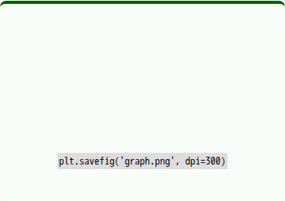




Exporting for Reports
.savefig()
DPI (Resolution)
Transparency
Save your plot as PNG, JPG, or PDF.
Use dpi=300 for high-quality print reports.
Use transparent=True for presentation slides.
10

Slide 11
Best Practices
•
Label Everything: A graph without Axis Labels (Units) is useless in engineering.
•
Colorblind Friendly: Avoid relying solely on Red vs. Green. Use markers or different linestyles.
•
Less is More: Don't clutter the graph. High data-to-ink ratio.
11

Slide 12

Lecture 8: Take-Home Assignment
Weather Station Dashboard
Task: Load the sua_weather.csv file from the previous lecture.
Requirements: Create a Python script that generates a single image containing 2 subplots (stacked vertically):
1.
Top Plot: A Red Line chart of Temp_Max over time.
2.
Bottom Plot: A Blue Bar chart of Rainfall_mm over time.
3.
Labels: Add proper Titles, Axis Labels (Date, Deg C, mm), and a grid to both.
4.
Save: Export the result as weather_report.png.
12

Slide 13
Questions?
Next Class: Mid-Semester Project Review
Dr. Kadeghe G. Fue
Department of Agricultural Engineering
13

